Slide 1


Effective c++
Andrei Toader

Slide 2
EFFECTIVE C++
Prefer c++ style casts
C++ introduces four new cast operators
static_cast<type>(expression)
const_cast<type>(expression)
dynamic_cast<type>(expression)
reinterpret_cast<type>(expression)
“The need for dynamic_cast generally arises because you want to perform derived class operation on a derived class object, but you have only a pointer or reference-to-base.”

Slide 3
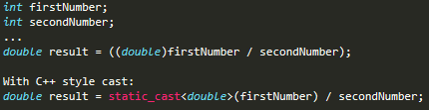
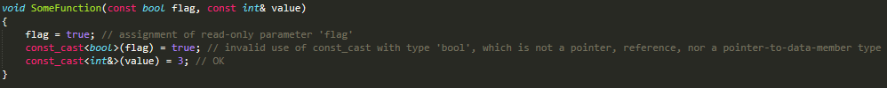
EFFECTIVE C++
Prefer c++ style casts

Slide 4
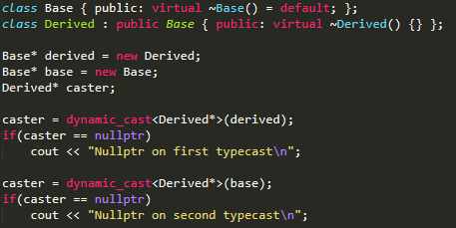
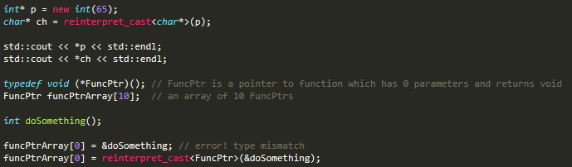
EFFECTIVE C++
Prefer c++ style casts

Slide 5
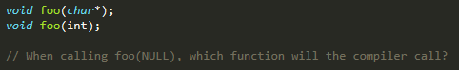
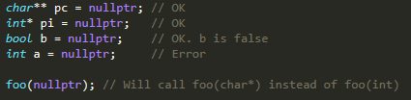
EFFECTIVE C++
Nullptr
The constant 0 has had the double role of constant integer and null pointer constant.
This, of course, has led to ambiguity…
The ambiguity came from the preprocessor macro NULL, which was expanded as 0.
C++11 corrected this by introducing a new language keyword: nullptr.

Slide 6
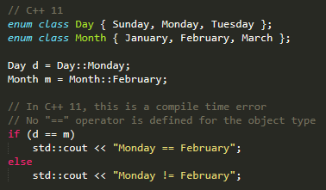
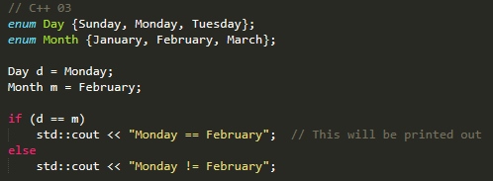
EFFECTIVE C++
Strongly typed enumerations
In C++03 enumerations are not type-safe. They are effectively integers, even when enumeration types are distinct.
From Bjarne Stroustrup’s C++11 FAQ:
- “Conventional enums export their enumerators to the surrounding scope, causing name clashes.”

Slide 7
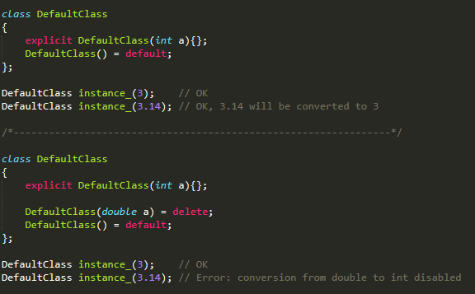
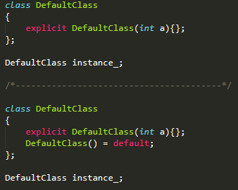
EFFECTIVE C++
Default and delete
If a class is defined with any constructors, the compiler will not generate a default constructor.
C++11 allows us to disable certain features by using delete.

Slide 8
EFFECTIVE C++
Be wary of implicit conversions
In honor of its C heritage, C++ allows implicit conversions between types. E.g: silent conversion from char to int, or short to double etc…
You can’t do anything about such conversions because they are hardcoded in the language. However, when you have your own types you have more control.
Two kinds of functions allow compilers to perform such conversions: single-argument constructors and implicit type conversion operators.
The fundamental problem with these functions is that they end up being called when you neither want or expect them to.
This leads to definitely more difficult programs to diagnose, debug.
Solution: the “explicit” keyword for constructors and user defined conversion function.

Slide 9
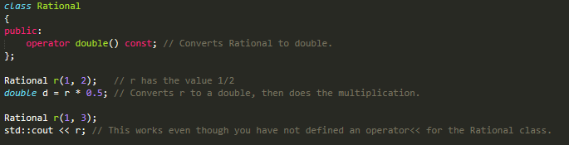
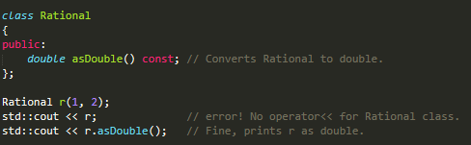
EFFECTIVE C++
Be wary of implicit conversions

Slide 10
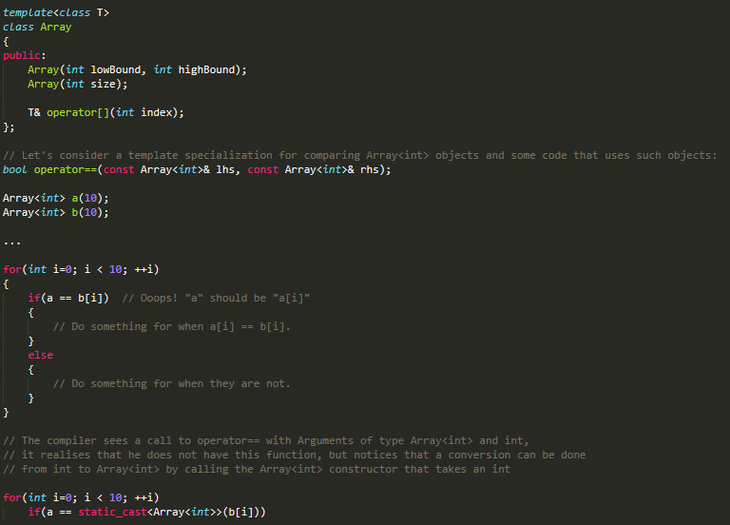
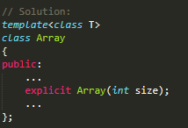
EFFECTIVE C++
Be wary of implicit conversions

Slide 11
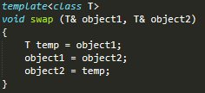
EFFECTIVE C++
Temporary objects
In this case it is common to call temp a “temporary”.
As far as C++ is concerned, temp is not a temporary at all. It’s simply an object local to a function.
True temporary objects arise whenever a non-heap object is created, but not named.

Slide 12
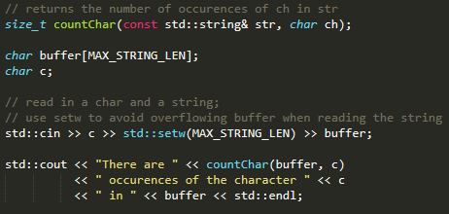
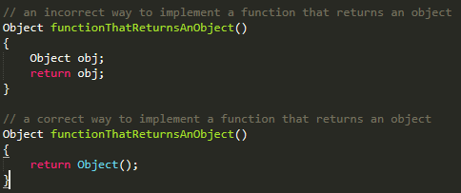
EFFECTIVE C++
Temporary objects
Real temporaries arise in two different situations:
- implicit type conversion to make function calls succeed
- when functions return objects

Slide 13
EFFECTIVE C++
Never treat arrays polymorphically
C++ allows you to manipulate arrays of derived class objects through base class pointers and references.
This is no feature at all, because it almost never works the way you want it to.
Solution:
Instead of having an array of objects, an array of pointers solves the problem of the objects being of different sizes.

Slide 14
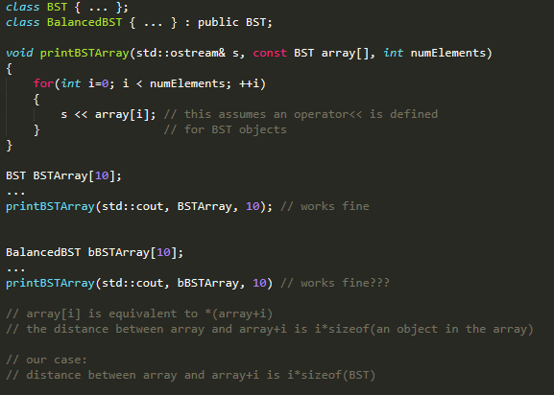
EFFECTIVE C++
Never treat arrays polymorphically

Slide 15
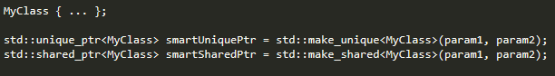
EFFECTIVE C++
Smart pointers
A smart pointer is a class that wraps a ‘raw’ C++ pointer, to manage the lifetime of the object being pointed to.
STL offers us three smart pointers:
std::unique_ptr<T>, std::shared_ptr<T>, std::weak_ptr<T>
Prefer std::make_unique<T> and std::make_shared<T>

Slide 16
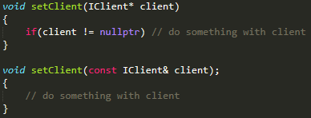
EFFECTIVE C++
Prefer references to pointers
References have clearer semantics:
References allow value semantics in templates and operators.
Algorithms and containers in the standard C++ library are written as if operating on values, not pointers.
References enable move semantics starting with C++11.

Slide 17
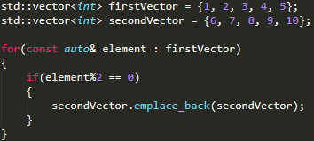
EFFECTIVE C++
Algorithms
The C++ STL offers a variety of algorithms, already implemented, and ready to be used!
E.G: std::copy, std::copy_if, std::for_each, etc…

Slide 18
THANK YOU

